Slide 1


Slide 2
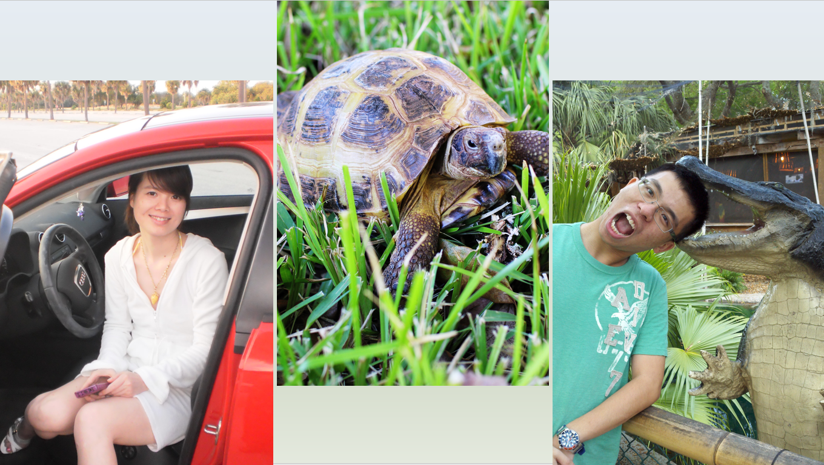

Slide 3
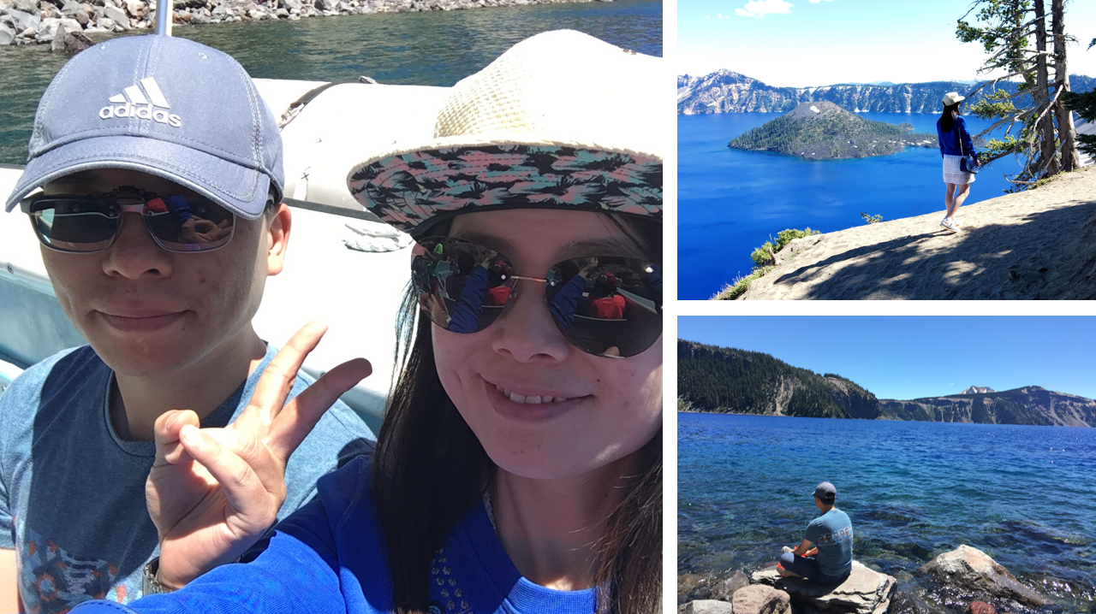

Slide 4
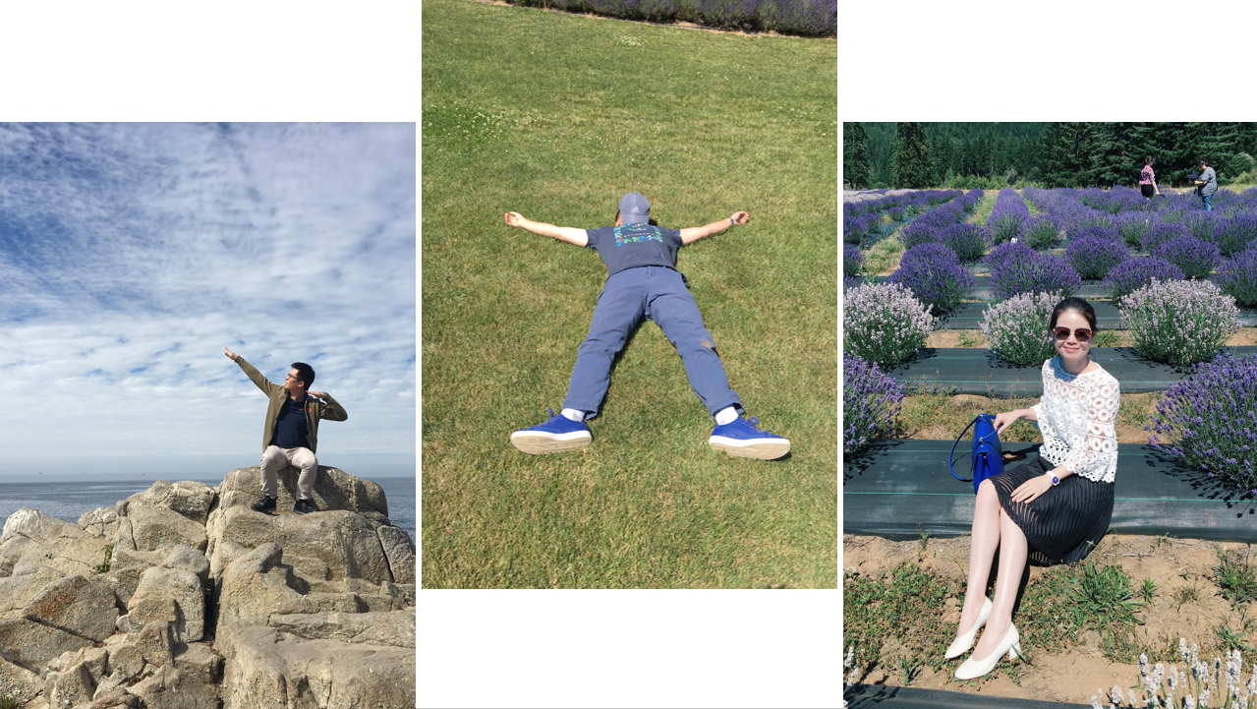

Slide 5
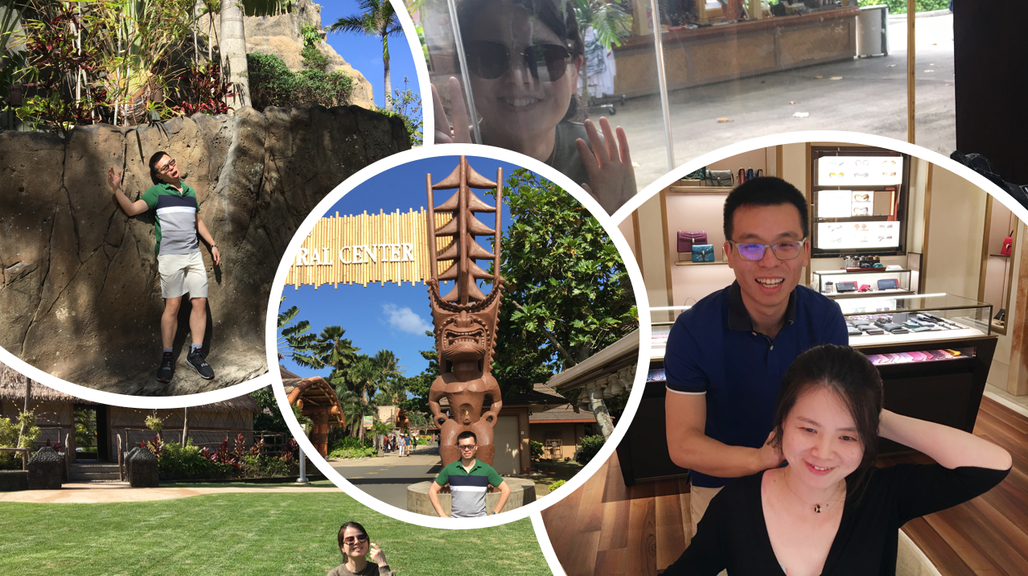

Slide 6
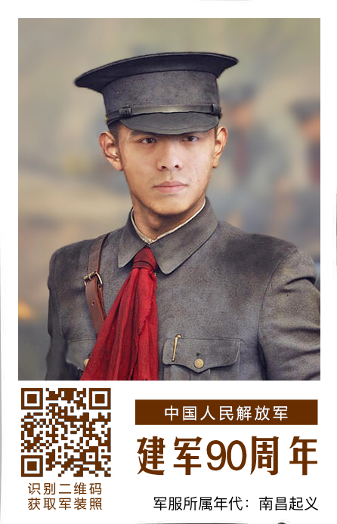
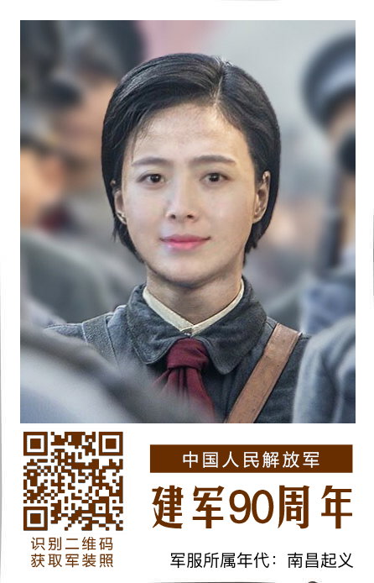

Slide 7
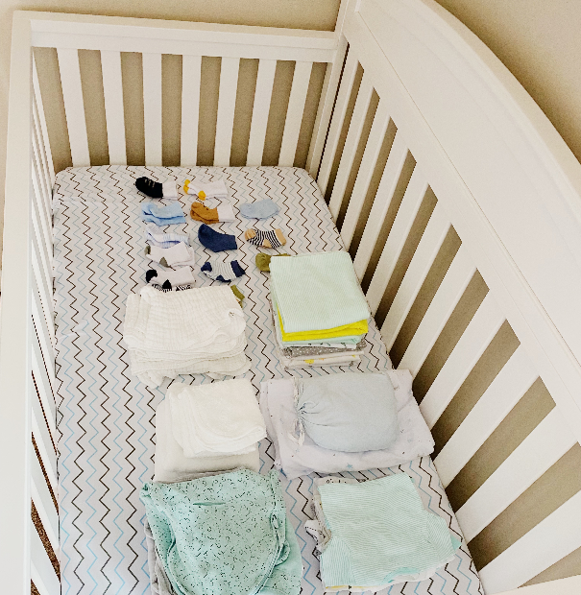
Thank You for the Cute Gifts!

Slide 8
Team-up Questions
Competition by Team
With Breakout Rooms

Slide 9


Slide 10
In each category, the players will be given 180 seconds to hunt for the items. They will have to step away from their computers to find the items.
After the game, total all the items with their designated points and and whoever has the highest points will be the winner!
INSTRUCTIONS

Slide 11
READY?

Slide 12
1 POINT
🔘 Gum/candy
🔘 Keys
🔘 Lotion
🔘 Mirror
🔘 Lipstick
🔘 Pen/pencil
🔘 Comb/brush
🔘 Sunglasses
🔘 Reading glasses
🔘 Tissue
🔘 Wet wipes
🔘 Notepad
🔘 Store punch card
🔘 Sanitizer
🔘 Picture frame
🔘 Perfume
🔘 Planner
🔘 Book
🔘 Scissors
🔘 Alcohol
Next

Slide 13
2 POINTS
🔘 Nail polish
🔘 Toothpick
🔘 Dental floss
🔘 Paperclip
🔘 Coupons
🔘 Grocery list
🔘 Grocery receipt
🔘 Flashdrive
🔘 Headphones
🔘 Mail
🔘 Band aid
🔘 Aspirin
🔘 Tweezers
Next

Slide 14
3 POINTS
🔘 Toothbrush
🔘 Teabag
🔘 Shaver
🔘 Ketchup
🔘 Restaurant menu
🔘 Ear plugs
🔘 $50 dollar bill
🔘 Shower invites
🔘 Passport
🔘 TV remote
🔘 Nail clippers
🔘 Nail polish remover
🔘 Toy car
Next

Slide 15
5 POINTS
🔘 Tape measure
🔘 Map
🔘 Ziplock bag
🔘 Spoon or fork
🔘 Deodorant
Next

Slide 16
10 POINTS
🔘 Pepper spray
🔘 Pic of the mom
🔘 Curling iron
🔘 Sewing kit
🔘 Diaper bag

Slide 17
THANKS FOR PLAYING!
Have a Wonderful Weekend

